Slide 1


MIE 1622: Robo-advisor
April 18, 2022
Pai Peng 1002725394
Liyan Liu 1002896100
Yiqi Fei 1003630314
Beishi He 1005039548
Zhengkun Chen 1004142331
Notes:
Hello everyone, thank you for watching Group 4’s presentation.

Slide 2
Content table
Product Overview
Chat-robot Design
DEMO WALK-THROUGH
Future
Notes:
Nowadays, developing a Robo-advisor is very useful as it can help investors clarify and reach their goals but is cheaper in terms of cost than consulting a traditional advisor. Our team has created a Watson Assistant chatbot platform on IBM Cloud that each user could express their financial attitudes. Watson Assistant chatbot would solve the portfolio optimization problem and give an optimal portfolio allocation based on the user's response and financial data. So, Let’s take a look at the first part, product review.

Slide 3

Product Overview
01

Slide 4

The demand
Our Solution
With the endless pandemic and escalated international conflict , financial instability has continued to be a concern.
But this also creates window for benefiting from the recovery of economics..
People with financial awareness want to invest.
But where to start?
The Robo-advisor for Investment strategies !
What we offer:
1. Optimal portfolio tailored to individual needs .
2. Performance backed by historical look-back.
Our advantages over real agents: 1. Lower cost. 2. No middle man. 3. Instant response.4. Historical performance

Slide 5

Chatbot
Design
02

Slide 6
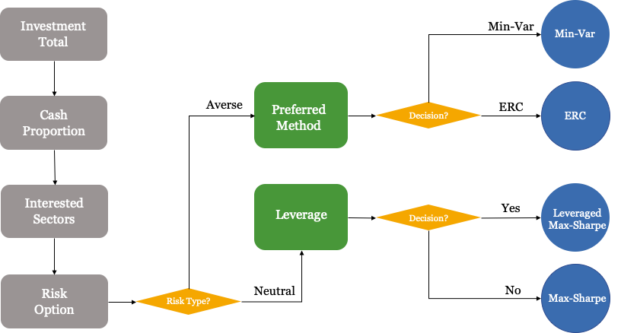
Question flow

Slide 7
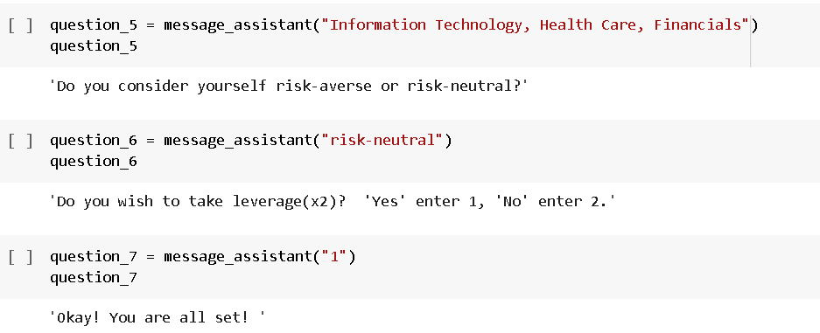
Some tech details – Chat Simulation
Check if the chat-robo behaves the way we expect it to.

Slide 8

Demo
Walk-through
03

Slide 9
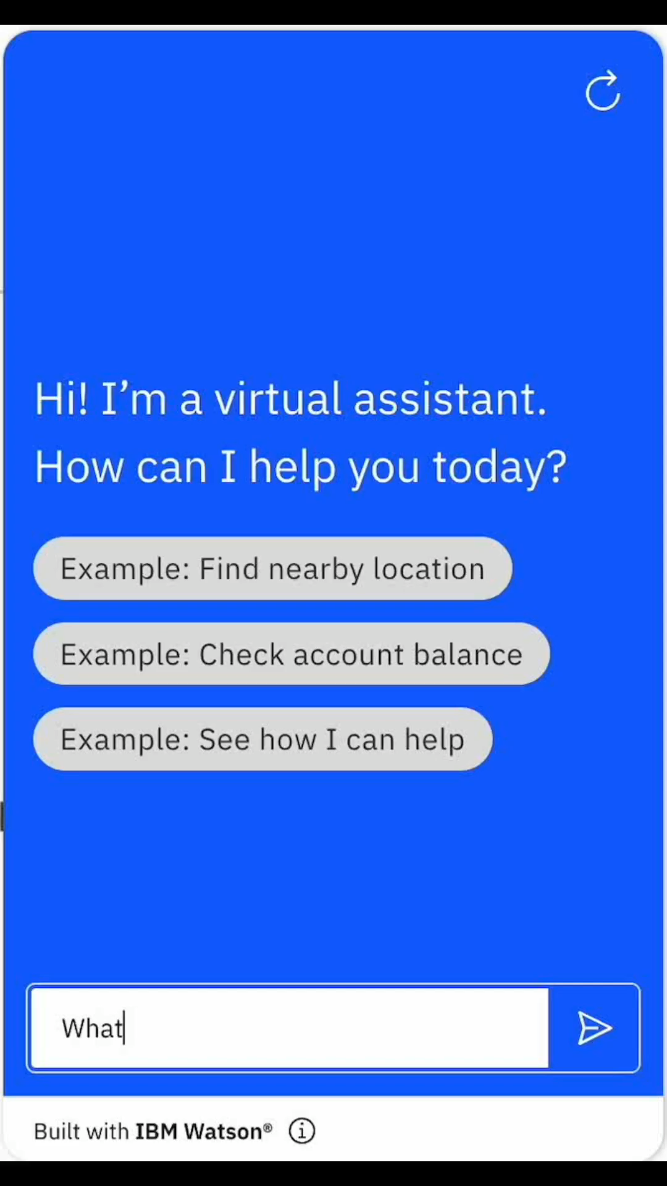
Chat User Interface
Video Link: https://drive.google.com/file/d/1FhTP2pz876BebiWP_K24ngrGhWKgXurk/view?usp=sharing

Slide 10

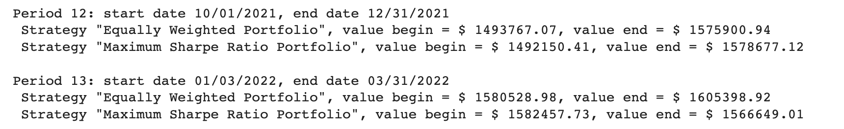
2. Backend process
After all the questions,, the chat history is immediately communicated to the backend and informations are extracted accordingly.
Based on the above information, the program decides what strategy to apply and returns optimal portfolio, historical performance chart and etc.

Slide 11
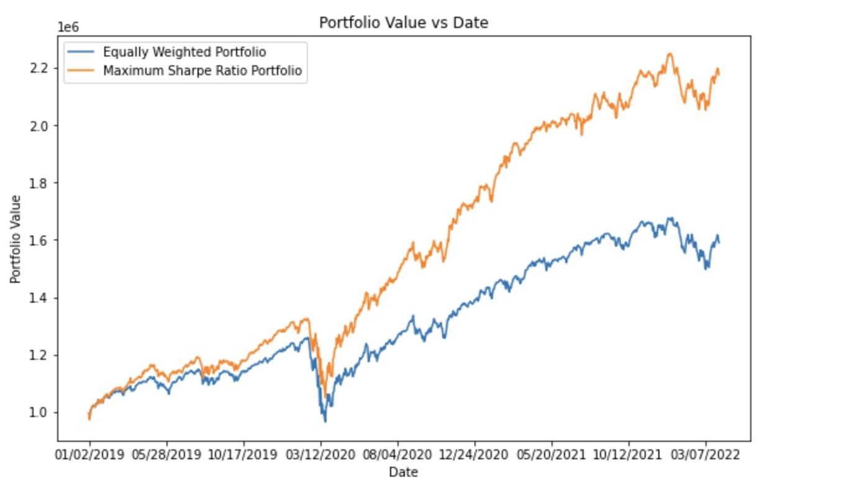

3. Deliverable
Portfolio value chart (2019-2022.4)
Average annual rate:
Strategy "Equally Weighted Portfolio", CAGR = 15.45%
Strategy "Maximum Sharpe Ratio Portfolio", CAGR = 27.15%
Portfolio weights(shares):

Slide 12

Future
improvements
04
Notes:
So in the following chapter we are going to talk about things that can be improved given time.

Slide 13

Extensions to the chat-bot
Know you better
Delivery option
Premium Features
Extending questions: rebalance frequency, expected return, risk tolerance
Making delivery autonomous
In additional to investment strategy, recommendations, macro advise
Notes:
1.s We keep the questions simple and compact for narrowing down the scope for presentation purpose. But there are obviously much more questions can be asked to further explore the client preference. Things like how often they wish to rebalance their portfolio or
2. We talked about how preference input are received autonomously. But we didn’t do much for the delivery of results. So there can be a various ways to do so, we can chat the result to client in the chat box, we can email the result or we can just have them show up in their account history. So this is more product-wise improvement.
3. I think that the robot or the product as a whole can do more than just receiving preferences and compute weights. It can be more intelligent, things like giving suggestions in macro extent to a client who wants to double his investment in 5 years. Or the robot can make recommendation when the client doesn’t have a clear preference or have little knowledge about the ETF markets. The list can keep going on and on, there are just many features we can add to make it better. For a better price thats for sure.

Slide 14

Extensions to the backend
Simulation
Up-to-date
data
Cutting-edge technology
Metric
Making delivery autonomous and in various way
Connecting to Yahoo Finance
Machine learning approach
Performance indicators: risk, max-drawdown, etc
Notes:
The data we use now are loaded from CSVs, they contain data until April 1st. But actually making it perfect we would want up-to-date data on daily basis. One way we can achieve that is to connect to yahoo-finance library to request daily updates.
Most of the performance are visualized using historical data. But the clients care more about possible furture performance. We don’t know exactly waht the future will be like but we have many powerful simulation tools that gives a rough picture. So providing simulation performance can be a big plus.
Also the methodologies we use are OLD-FASHIONED. Max-sharpe ratio, min-var methods that give theoraticaly closed-form SOLUTION. But that doesn’t equal profitability, introduction of some deep-learning model with Multiple-Factors might make a difference.
Last but not least, metrics. Or how we evaluate the performance. So far we only include annualizaed return and portfolio value as 2 metrics but there can be more. Standard deviation, max-drawdowns and so on. With more all-rounded view of the portofolio, the product will likely attract more experienced clients and that builds up the reputation and more benefits to come.

Slide 15



Thanks
We will take your questions now ^-^

